Slide 1

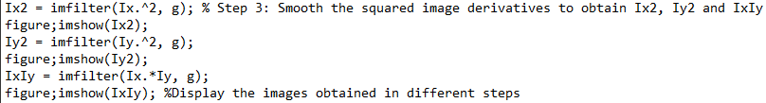
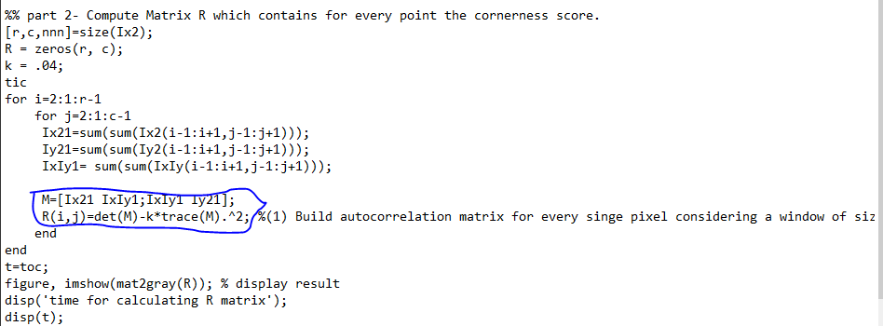
Import images
Compute the image derivatives Ix and Iy
-Using dx and dy filter
3. Smooth square image derivatives by using Gaussian filter
4. Compute score R by using formular

